Slide 1
Project 76 Group 04 Submitted by: Shreyas Anusha Meesala Anandhanarayanan A Pushkar Shanmukha Sri Vastava G Narayana venkatalohith

Slide 2
Business Problem Need to perform clustering to summarize customer segments.

Slide 3
Attributes ID: Customer's unique identifier Year_Birth: Customer's birth year Education: Customer's education level Marital_Status: Customer's marital status Income: Customer's yearly household income Kidhome: Number of children in customer's household Teenhome: Number of teenagers in customer's household Dt_Customer: Date of customer's enrollment with the company Recency: Number of days since customer's last purchase Complain: 1 if customer complained in the last 2 years, 0 otherwise MntWines: Amount spent on wine in last 2 years MntFruits: Amount spent on fruits in last 2 years MntMeatProducts: Amount spent on meat in last 2 years MntFishProducts: Amount spent on fish in last 2 years MntSweetProducts: Amount spent on sweets in last 2 years MntGoldProds: Amount spent on gold in last 2 years Promotion NumDealsPurchases: Number of purchases made with a discount

Slide 4
Continuation: AcceptedCmp1: 1 if customer accepted the offer in the 1st campaign, 0 otherwise AcceptedCmp2: 1 if customer accepted the offer in the 2nd campaign, 0 otherwise AcceptedCmp3: 1 if customer accepted the offer in the 3rd campaign, 0 otherwise AcceptedCmp4: 1 if customer accepted the offer in the 4th campaign, 0 otherwise AcceptedCmp5: 1 if customer accepted the offer in the 5th campaign, 0 otherwise Response: 1 if customer accepted the offer in the last campaign, 0 otherwise NumWebPurchases: Number of purchases made through the company’s web site NumCatalogPurchases: Number of purchases made using a catalogue NumStorePurchases: Number of purchases made directly in stores NumWebVisitsMonth: Number of visits to company’s web site in the last month

Slide 5
Data cleaning
Check for unwanted columns, null values, replacing null values, duplicates etc..
df = data.drop(["Z_CostContact","Z_Revenue"], axis=1)
df.isnull().sum() “Income attribute has 24 null values”
df['Income'] = df['Income'].replace(np.NaN, df['Income'].mean())
data1=df.drop_duplicates()

Slide 6
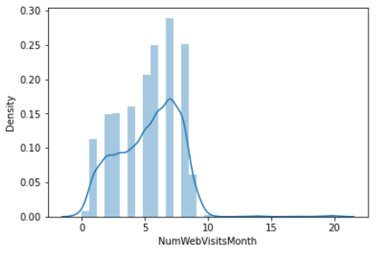
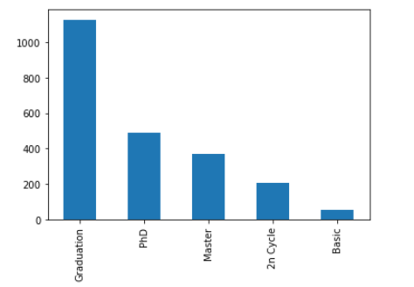
Uni-variate analysis without considering relationships with other variables

Slide 7
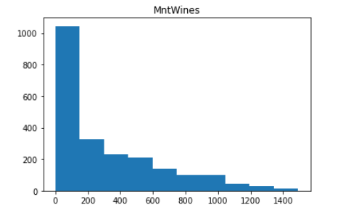
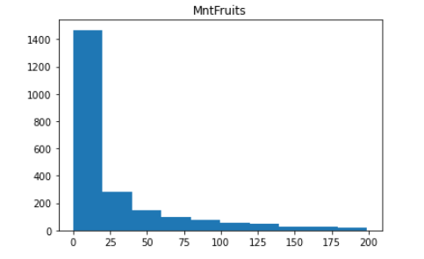
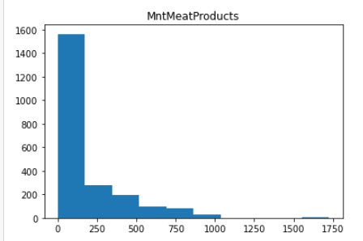
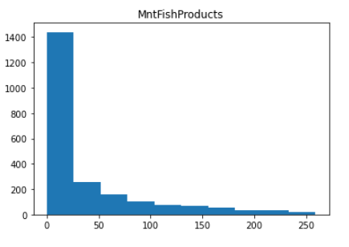

Slide 8
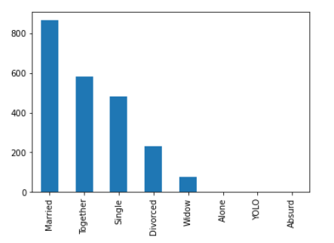
Difference in Marital_Status
Married 864
Together 580
Single 480
Divorced 232
Widow 77
Alone 3
YOLO 2
Absurd 2

Slide 9
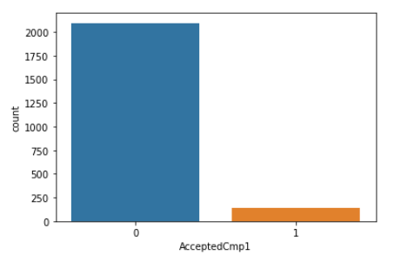
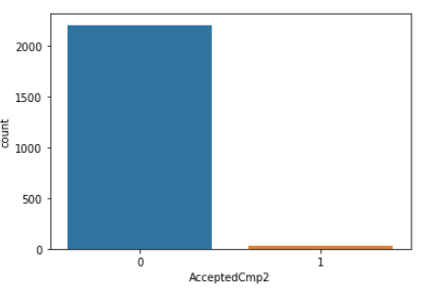
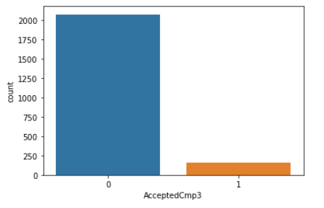
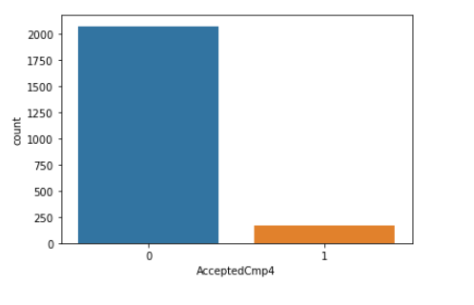
Customers accepting offer in 1st, 2nd ,3rd,4th and 5th campaigns

Slide 10
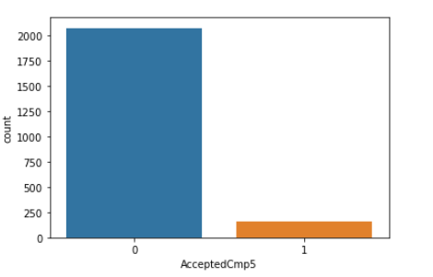
Continuation:

Slide 11
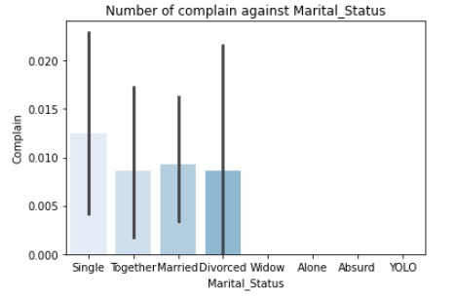
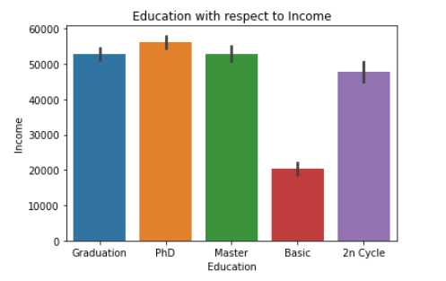
Bi-variate analysis

Slide 12
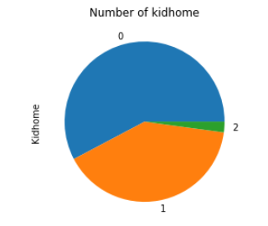
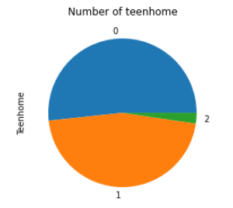

Slide 13
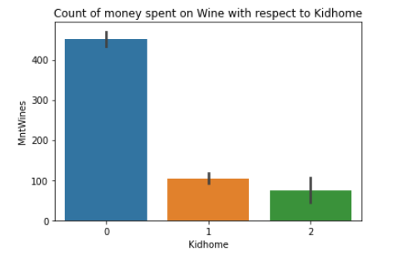
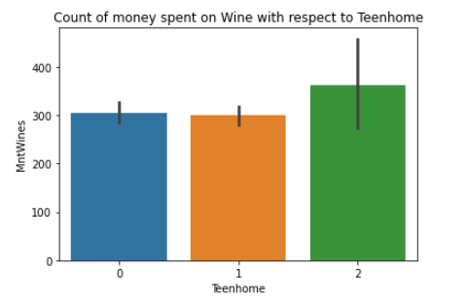
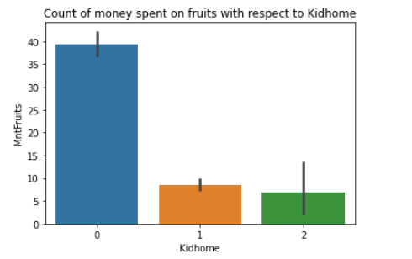
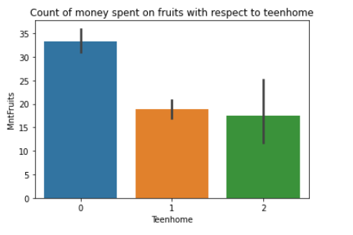

Slide 14
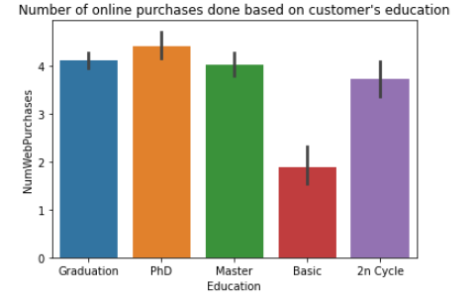
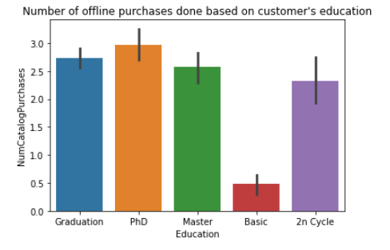

Slide 15
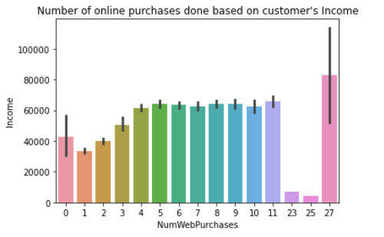
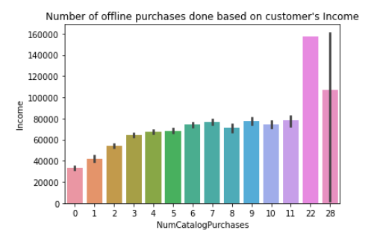

Slide 16
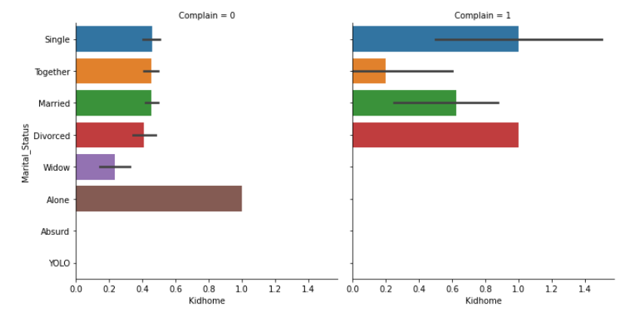
Number of complain with marital status respect to kidhomes

Slide 17
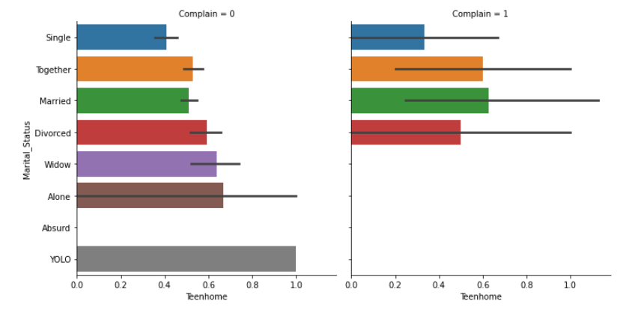
Number of complain with marital status respect to Teenhome

Slide 18
Correlation analysis

Slide 19
